Slide 1





The Influence of Video Games on Physical Activity in Sedentary Children

Slide 2
Meet The Team
Ahmed Abd Elhalim Abd Elmonam
Abdalluh Mohamed Aly
Mark Michel Bushra
Youssef Ashraf Abozaid

Slide 3



Introduction
Study Purpose:
To assess how active video game interventions influence the physical activity levels and screen-based behaviors of sedentary children.
Focus on data collected at various stages: baseline, intervention (6 weeks), and post-washout (10 weeks).
Study Scope:
Data collected includes physical activity via accelerometer, self-reported activity, and motivation levels.
Analysis of demographic, motivational, and behavioral factors influencing activity.

Slide 4

Data Sources
Accelerometer Data:
24-Hour Recall Data:
ActiGraph used to measure physical and sedentary activities at baseline, 6 weeks, and 10 weeks.
Describes children's daily activities at baseline, weeks 2, 4, 6 (after the intervention), and 10 (after washout).
Demographic Data:
Includes weight, height, gender, race, ethnicity, and birth year.
Questionnaire Data:
Exercise Self-Efficacy: CSAPPA scale.Motivation for Physical Activity: BREQ-2 scale.Motivation for Active and Sedentary Video Games: Modified BREQ-2 scale.Parenting Behaviors: ACTS-MG scale.
Relative Reinforcing Value Data:
Children rated preference for physical and sedentary activities on a scale of 1-10 at baseline, week 6, and week 10.

Slide 5


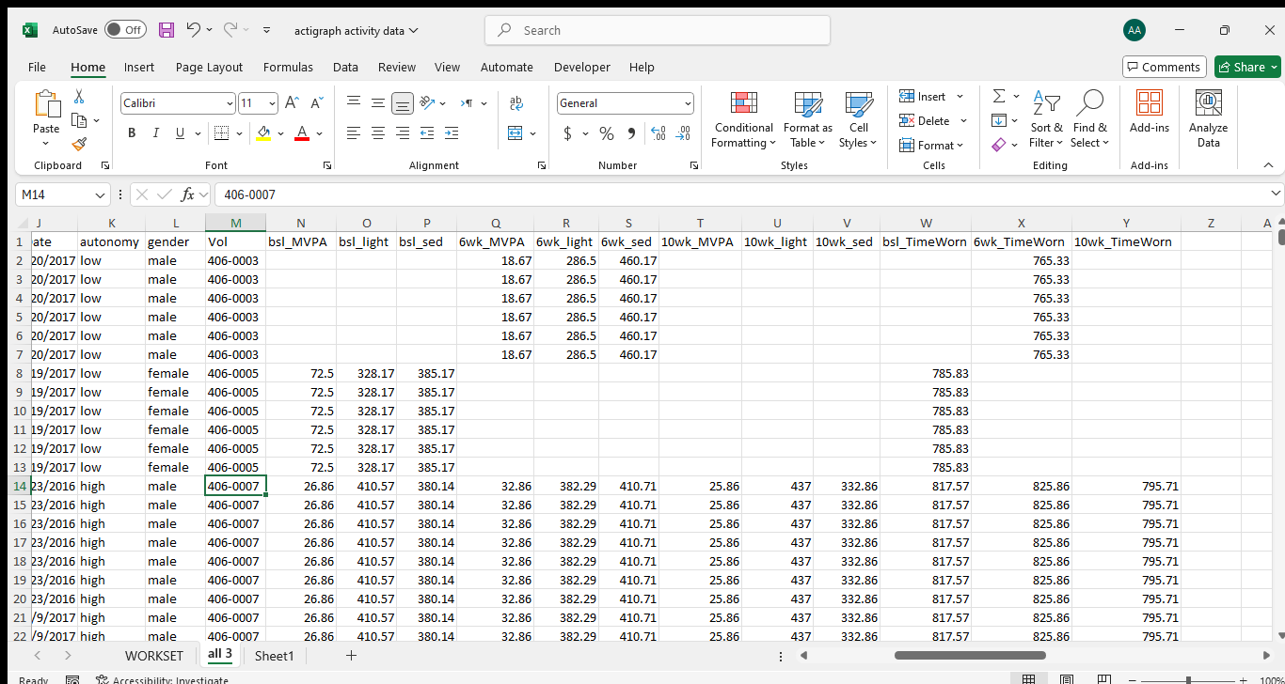
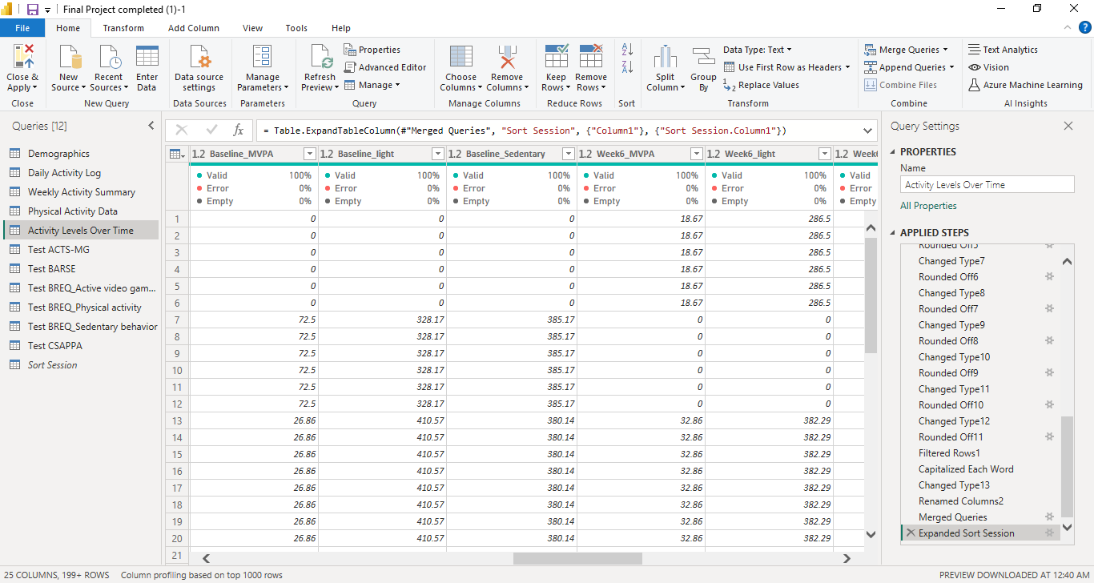
Data Cleaning Process
1. Handling Missing Data:
Filled in missing values, especially in 24-hour recall and accelerometer data.
2. Standardizing Data:
Ensured consistent formats for dates, labels (e.g., gender, race), and aligned timeframes for comparison.
3. Removing Outliers:
Identified and removed extreme or invalid values in activity and motivation data.
4. Merging Data:
Combined data from different sheets (e.g., demographics, accelerometer, and questionnaires) using child IDs.
5. Data Transformation:
Converted some data into simpler formats (e.g., weekly activity totals) for easier analysis.

Slide 6


Key Analysis Questions
How does active video game play influence physical activity in children?
Do sedentary video games negatively affect physical activity?
What role do demographic factors (e.g., gender, age) play in activity levels?
How do parental behaviors influence children's physical activity?
How did children’s motivation for physical activity change over time
Did motivation for active video games correlate with increased physical activity

Slide 7



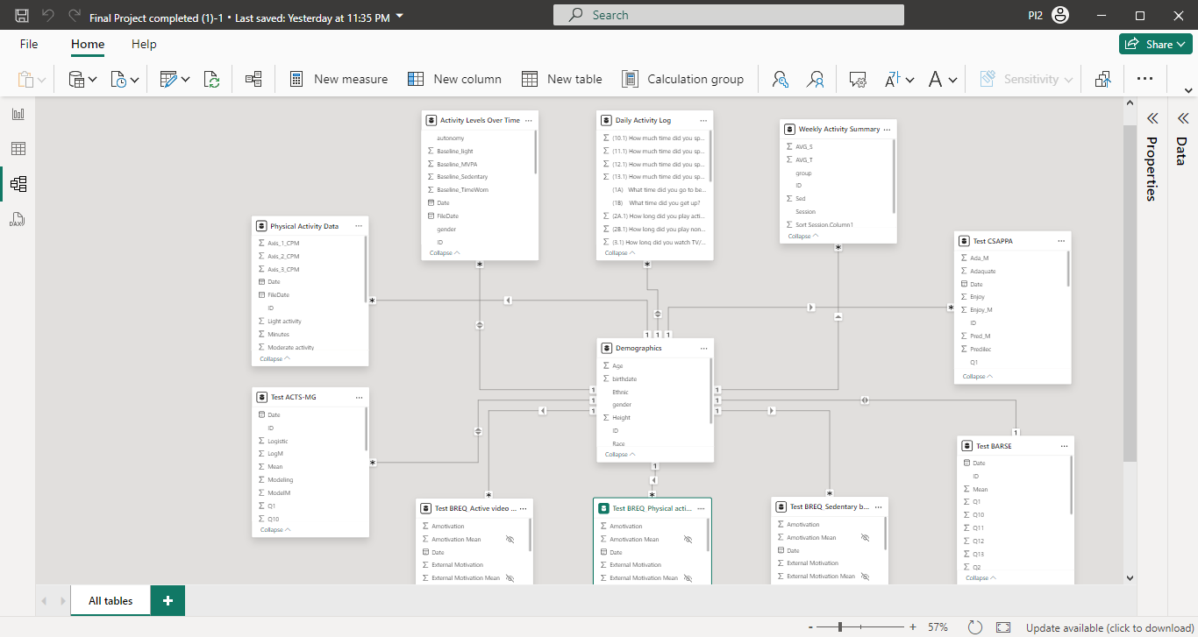
Data Relationships
Relationships Established:
All datasets (e.g., 24-hour recall data, accelerometer data, questionnaires, demographics) were linked through a unique identifier (Child ID) to allow for easy comparison across data sources so we make Child ID a Primary Key.
*
Star Schema of The Model

Slide 8

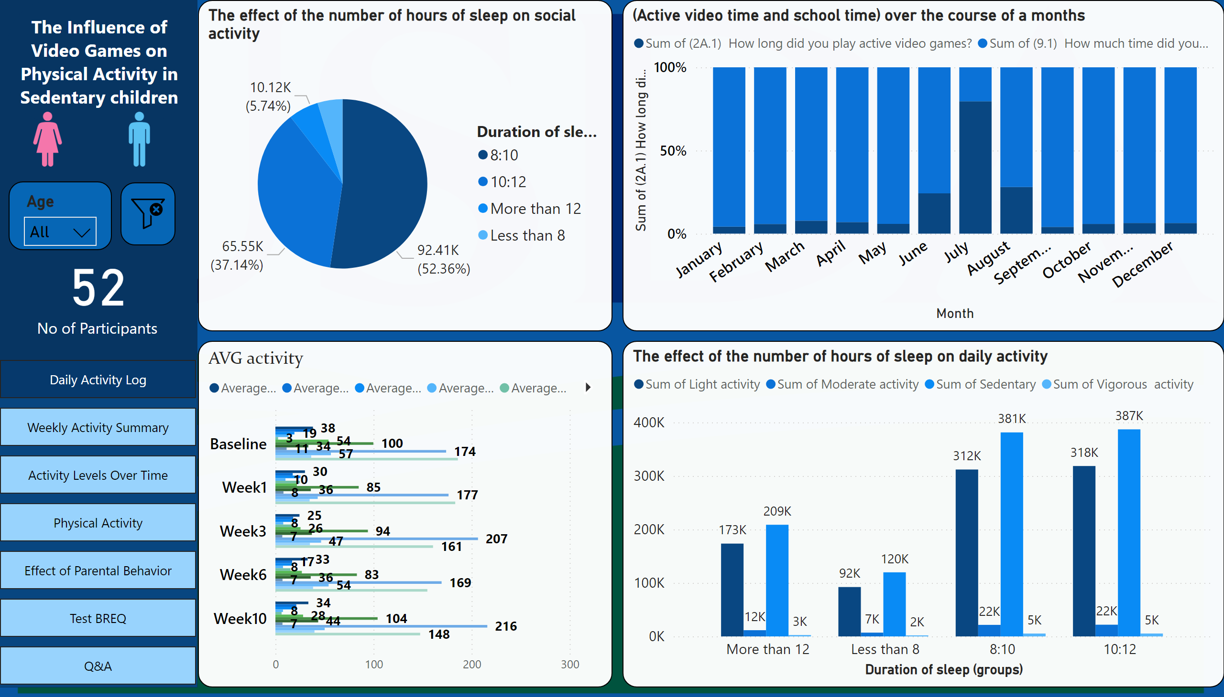
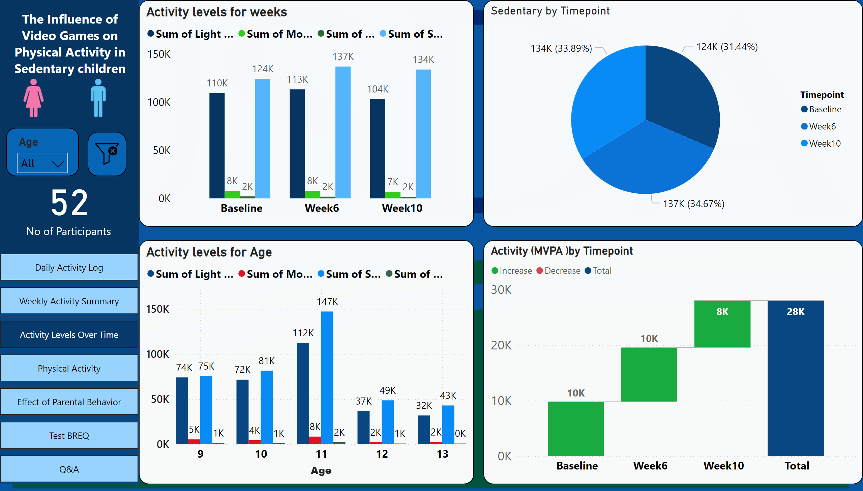
Dashboard Design
Visualizations:
Comparison between activity levels during intervention (active vs. sedentary games).
Trends in physical activity across different time points (baseline, week 6, week 10).
Correlations between demographic factors and activity levels.Motivation for physical vs. video games over time.

Slide 9
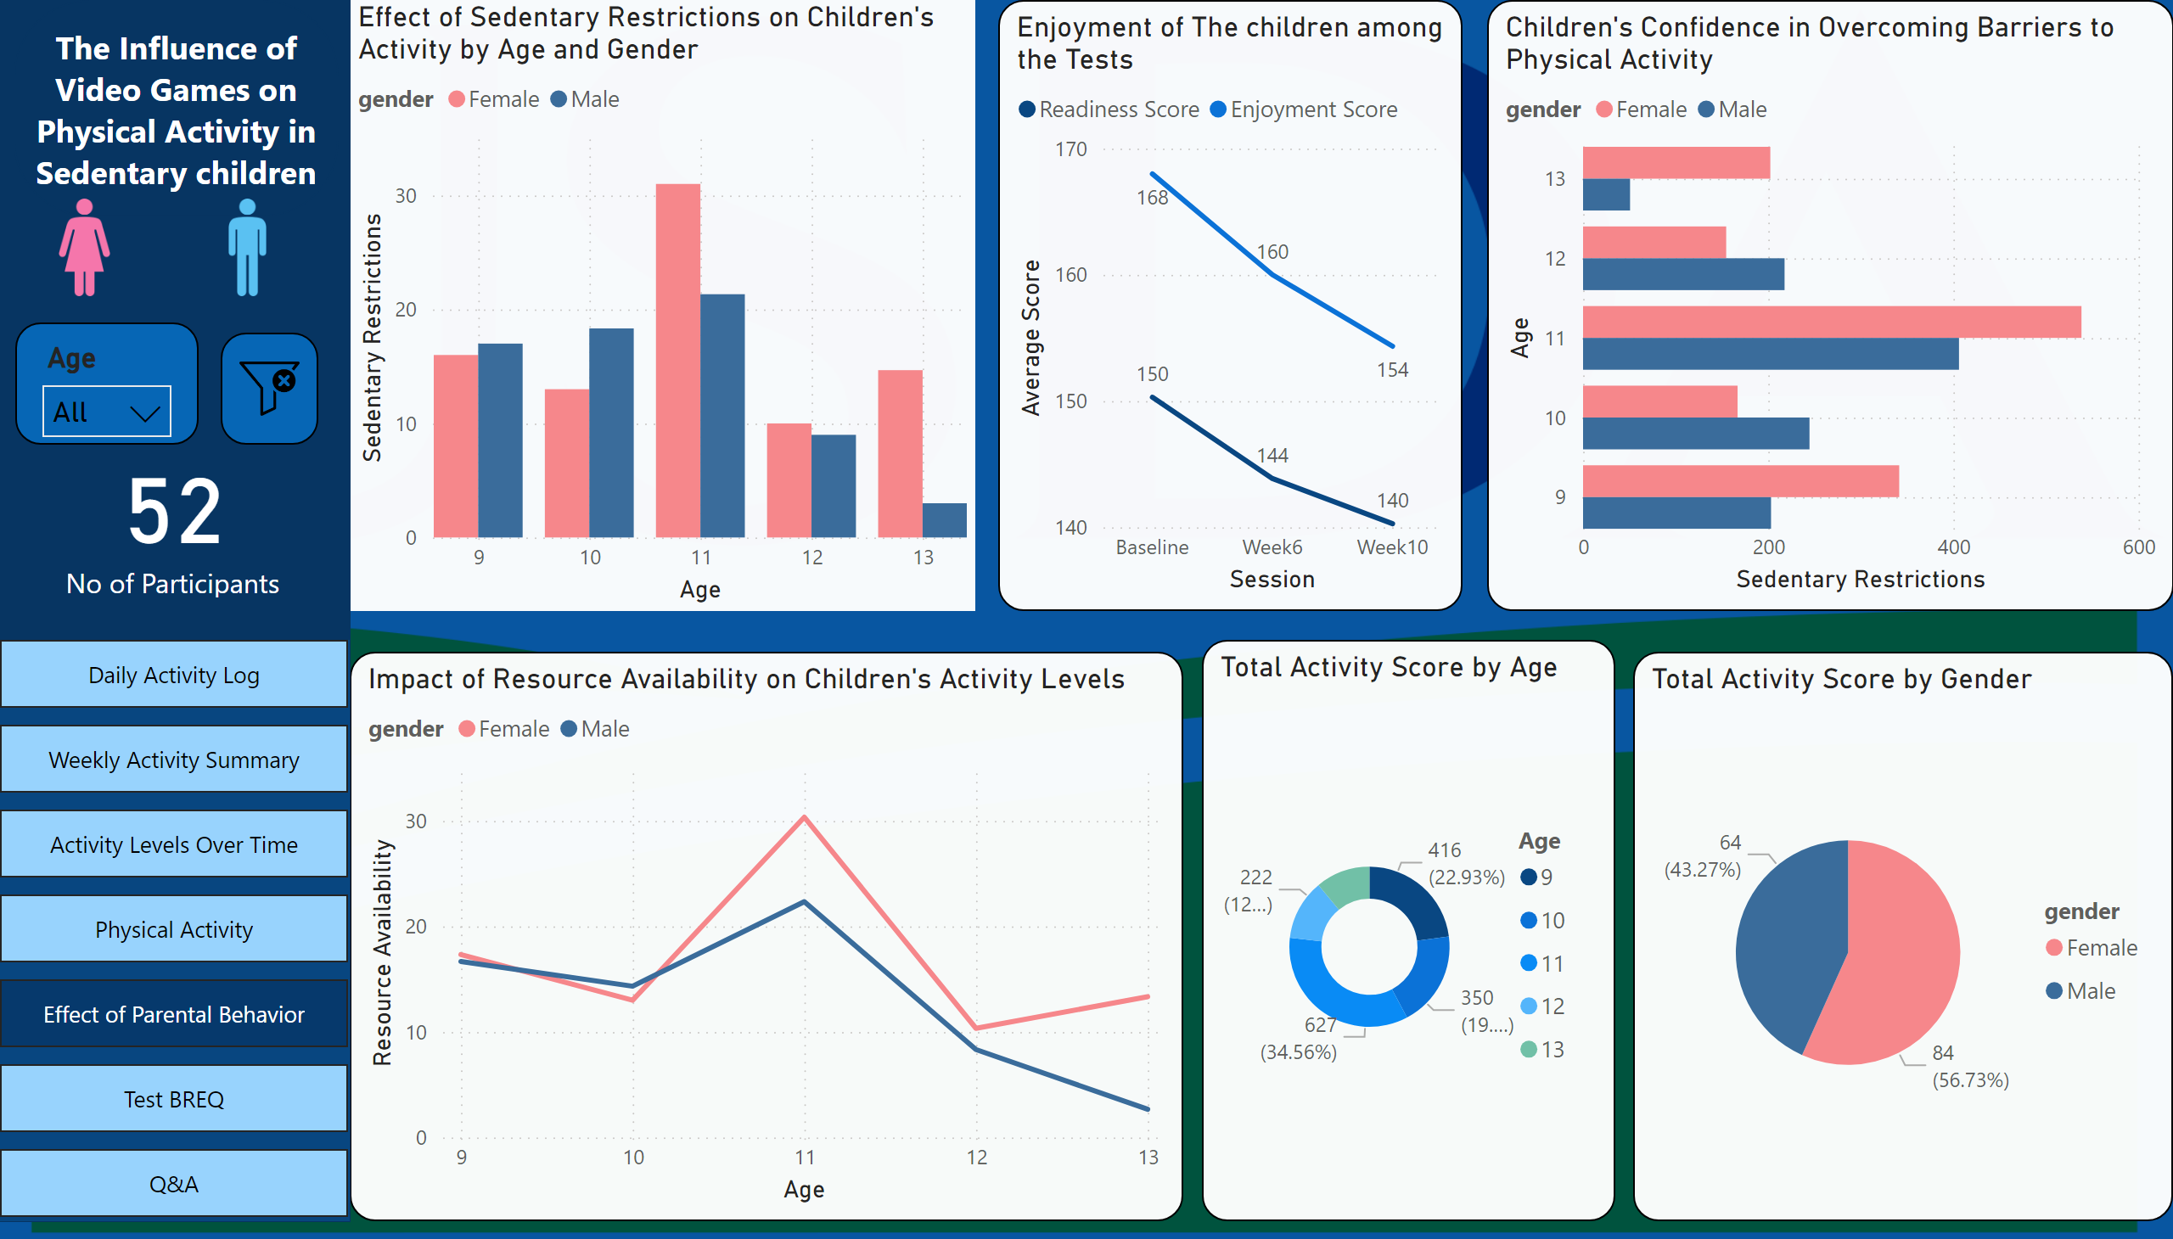
Dashboard Design

Slide 10

Conclusion
Positive Impact of Active Video Games: The intervention led to an increase in physical activity among children, especially during the 6-week period.
Sustained Activity Levels: While activity decreased post-washout, some children maintained higher levels compared to baseline.
Motivation Matters: Children with higher motivation for active games were more likely to increase their physical activity.
Recommendations:
Encourage Active Video Game Play: Schools and parents should consider integrating active video games as part of regular physical activity routines for sedentary children.
Sustain Activity Post-Intervention: Future programs should include follow-up activities or continuous engagement to prevent drop-offs in physical activity after interventions.
Parental Engagement: Educate parents on the importance of their role in supporting children’s physical activity to maximize the impact of such interventions.

Slide 11

THANK YOU

